Slide 1
A Reassessment Discussion

Slide 2
Reassessment
(Section 102 RPTL)
A systematic analysis of all locally assessed parcels to ensure that all assessments are at a stated uniform percentage of value as of the valuation date of the assessment roll upon which the assessment appear.

Slide 3
Who is responsible for assessments and who is responsible for taxes?
Assessments are determined by the Assessor and are based on market value. Market value is how much your property would sell for under normal conditions. Once the assessor estimates the market value of your property, the assessment is calculated.
Your taxing jurisdiction (school district, town, county, etc.) is responsible for developing and adopting a budget. There are several steps involved in this process. Revenue from all sources other than the property tax is determined. These revenues are subtracted from the budget to arrive at the tax levy – the total amount to be raised through the property tax.
The tax rate for properties in your community is then determined by dividing the tax levy by the total taxable assessed value of taxable real property in your community (tax levy¸ total assessed value = tax rate).

Slide 4
The Job of the Assessor
Provide fair assessments by determining the market value of each property
Help taxpayers understand assessments
Work with the county, state, and contractors to ensure assessments are fair
Process exemptions, such as STAR, Senior Citizens, Agriculture, and Veterans
Maintain the assessment roll and related data using computerized software
Notes:
The Assessor DOES NOT set the tax rate . . .

Slide 5
Assessment and Taxes
Although assessments play an integral part of tax calculation, the amount of the tax levy is the controlling factor in the amount of taxes we all pay.

Slide 6
WHERE THE REAL PROPERTY TAX GOES
(Newstead Tax Rates from 2019-2020)

Slide 7
Reassessment
So why
do we need
reassessments?

Slide 8
EQUITY is the GOAL
When assessment equity exists, it ensures that the tax burden is distributed equally and fairly among ALL taxpayers.

Slide 9
New York State Assessment Standard
The "Assessment Standard" (RPTL 305): "all real property in each assessing unit shall be assessed at a uniform percentage of value“
  "value" is defined as "market value" - the most probable sale price, in a competitive and open market, between a willing and knowledgeable buyer and seller, made without duress to either party
  tax bills must display the municipality's uniform percentage and the parcel's market value

Slide 10
New York State Equalization Rate
The NYS Office of Real Property Tax Services (NYSORPTS) periodically performs a Market Value Survey which assists that office in establishing an Equalization Rate.
An Equalization Rate is an overall measure of a municipality’s level of assessment relative to market value.
The Market Value Survey conducted by NYSORPTS also provides a measure of assessment equity within the property class groups sampled.

Slide 11
Why Does Equity &Uniform Assessing Matter?

Slide 12

NON-UNIFORM ASSESSING
Property A
Present Market Value
$100,000
Property B
Present Market Value
$100,000
Assessed Value
$80,000
Assessed Value
$120,000
If Tax rate = $20/1000
Estimated Taxes = $1,600
Estimated Taxes = $2,400

Slide 13
UNIFORM ASSESSING
Property A
Market Value
$100,000
Property B
Market Value
$100,000
Assessed Value
$100,000
Assessed Value
$100,000
If Tax rate = $20/1000
Estimated Taxes = $2,000
Estimated Taxes = $2,000

Slide 14
Things to keep in mind regarding property values & equity. . .
First, the real estate market is constantly changing
Second, not all properties will change in value at the same rate.

Slide 15
Changes in Property Values
Different types of properties in different locations do change in value at a different pace.
After a period of time without a reassessment and systematic analysis of all property values, the equity may diminish.
Loss of assessment equity will result in some people paying more than their fair share in taxes and some people paying less!
Notes:
This results in some people paying more than their fair share and some people paying less!

Slide 16
How Is Market Value Determined?
The Assessor does NOT create market value
Market Value is determined by the interaction of buyers and sellers.
The assessor monitors and analyses real estate transactions to establish market value estimates for real property within the town.

Slide 17
What Drives Market Value?
Location, Location, Location
Some locations are more desirable than others. Some people may desire lakefront or lake view property.
Some people may prefer to be near a city
Others may want to get back to nature
As communities age, Ranch Style homes may become more popular

Slide 18
What Drives Market Value?
Economic Influences
Interest Rates
Availability of amenities and jobs
Commuting Distance to industry
Consumer needs and the condition and amenities of a property
These among other factors may influence property values.

Slide 19
Reassessment - What It Does
Produces equity by eliminating unfair assessments
Distributes tax burden fairly within the municipality
Increases taxpayer confidence and understanding

Slide 20
Reassessment - What It Does Not Do
Generate additional revenue
Prevent tax shifts
Compensate taxpayers for prior inequities

Slide 21
The Property Tax
The Real Property Tax is an
Ad Valorem tax
(At value)

Slide 22
The Property Tax
...the amount of tax paid depends on the value of the real property owned multiplied by the tax rate per thousand.

Slide 23
The Property Tax
Calculation of Property Taxes:
  Amount of Tax Levy (Budget minus Revenues)
  Divided by Taxable Assessed Value (Assessed Value minus Exemptions)
  Equals Tax Rate (x 1000)

Slide 24
Reassessment Process
Data Collection/Verification
Inventory data file editing
Neighborhood analysis
Sales analysis
Application of MASS valuation techniques
Field Review/Appraisal
Assessment Disclosure
Informal meetings with taxpayers
Tentative Roll
Board of Assessment Review (BAR)
Final Roll

Slide 25
Assessment Change Notice
Mailed to all properties that have had a change in value

Slide 26
Informal Assessment Meeting
What are Informal Meetings?
  Informal Platform for the public to present information to the Assessor.
  Non-confrontational
  Information sharing
  Time very limited – 5-10 minutes, it is important to come prepared.

Slide 27
Informal Assessment Meeting
Objectives:
  Verify Data
  Review Exemptions
  Listen to taxpayers concerns and perspective
  Correct mistakes
  After hearing – Assessor reviews assessment(s)
    Single Parcel
    Group of Parcels

Slide 28
Informal Assessment Meeting
What you should NOT do:
  Focus on percentage of change
  Focus on amount of taxes
  Focus on irrelevant issues
    i.e.: Purchase price of property in 1975
  Attack
  Use the condition of your neighbor's house as a factor of your assessment without providing supporting proof of the impact on values in that specific area.

Slide 29
Informal Assessment Meeting
How to Prepare:
  Review Data/Inventory
  Focus on Assessed Valuation (Market Value)
  Search for comparable sales
  Bring relative data – recent appraisal
  Keep a positive attitude
  Remember the person you are meeting with is a professional appraiser/assessor with one objective in mind – to ensure that you are assessed at 100% fair market value.

Slide 30
Formal Review Process
Local Board of Assessment Review
Small Claims Assessment Review (SCAR)
Supreme Court – Certiorari/Article 7

Slide 31
When looking at your updated assessment, a good question to ask yourself . . .
Is the market value estimate the assessor has derived for my property a reasonable representation of what I would expect to receive for my property if it was offered for sale on the open market?

Slide 32
If You Would Like More Information:
Visit the New York State Office of Real Property Tax Services Web Site at:
www.tax.ny.gov

Slide 33
Thank You!!

Slide 34
What is Agricultural Assessment Anyway???

Slide 35
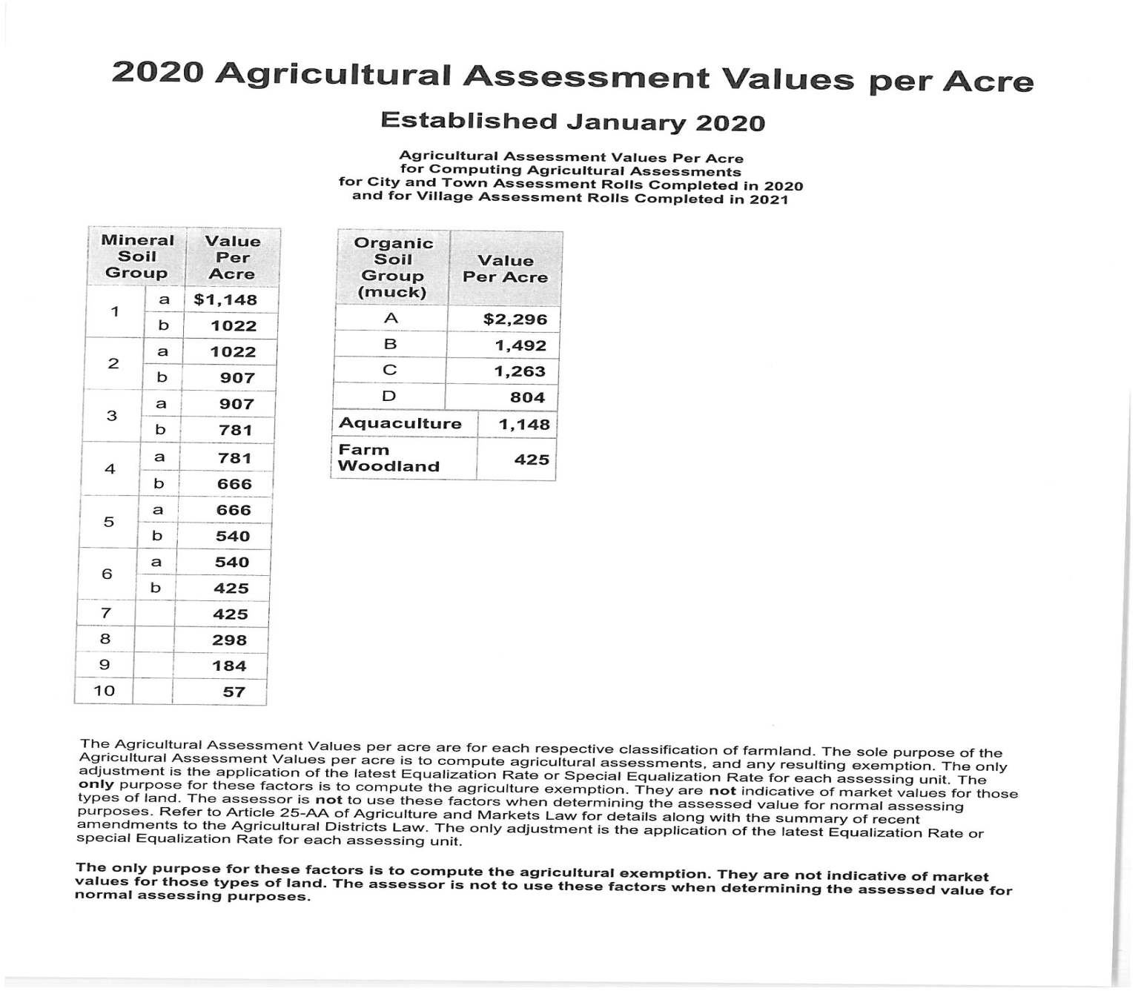
Agricultural Assessment Values 2020

Slide 36
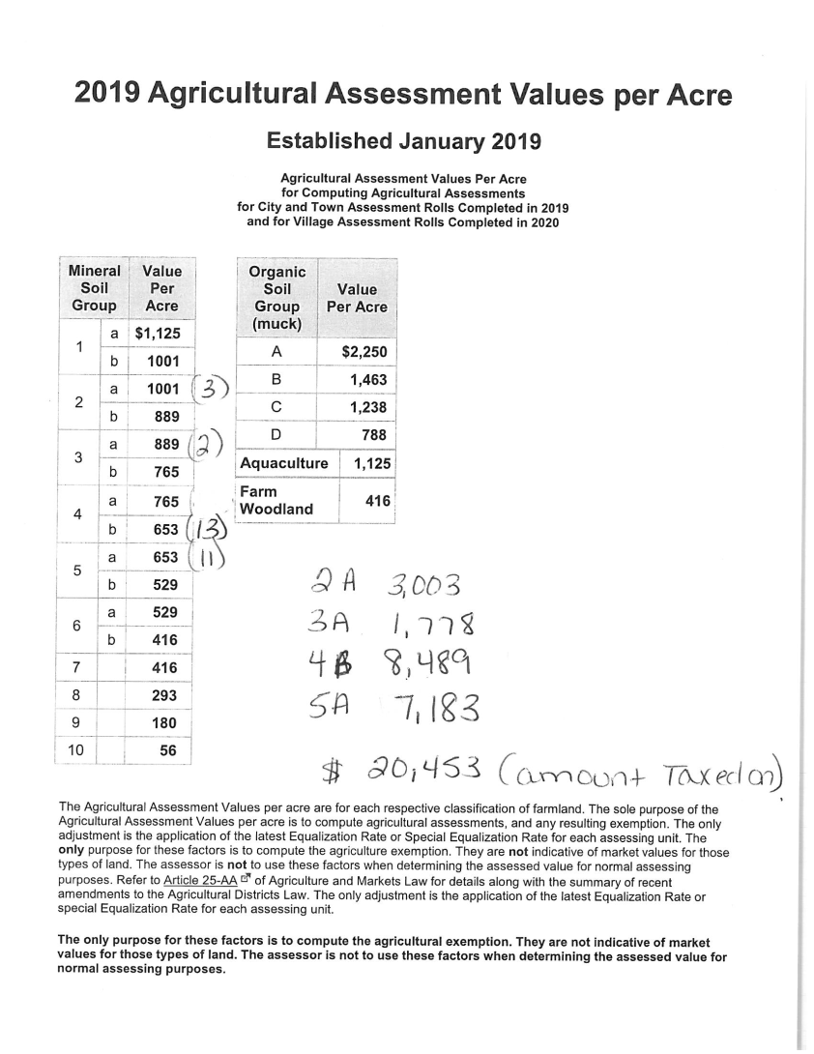
2019 Agricultural Assessment Values

Slide 37
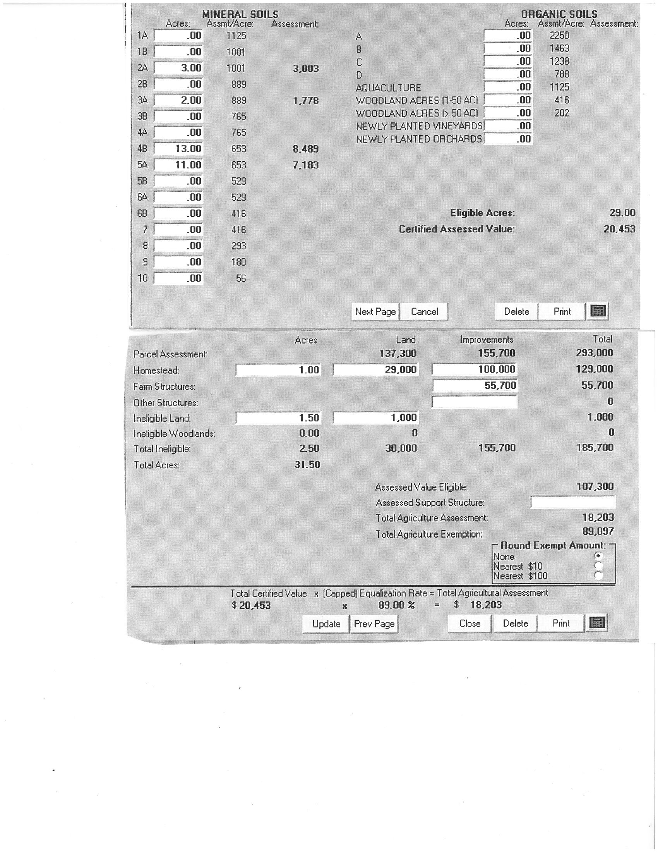
Soil Sheet Calculation on RPS

Slide 38
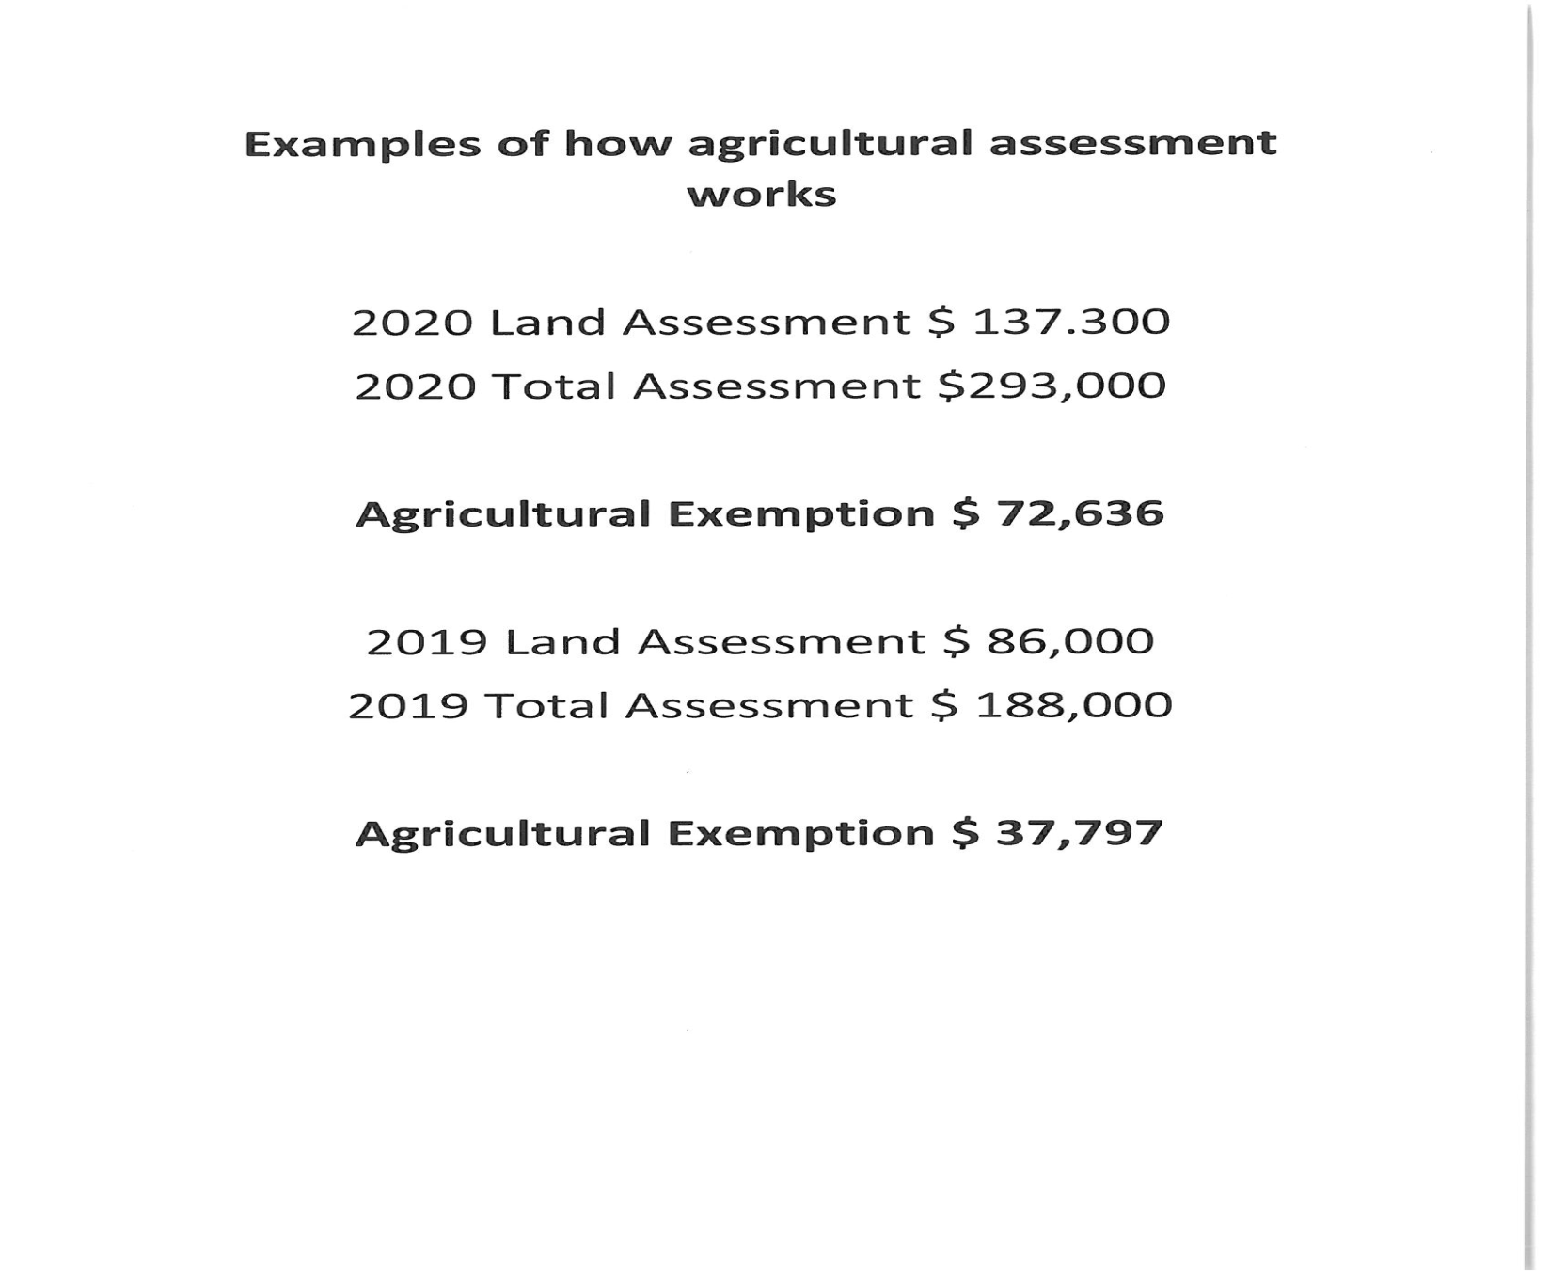
Examples

Slide 39
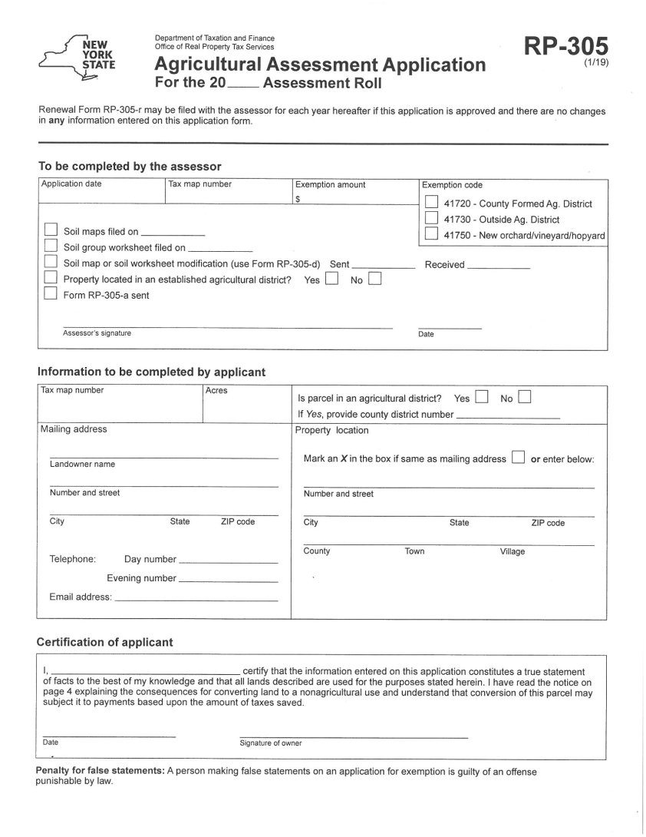
Agricultural Assessment Application

Slide 40
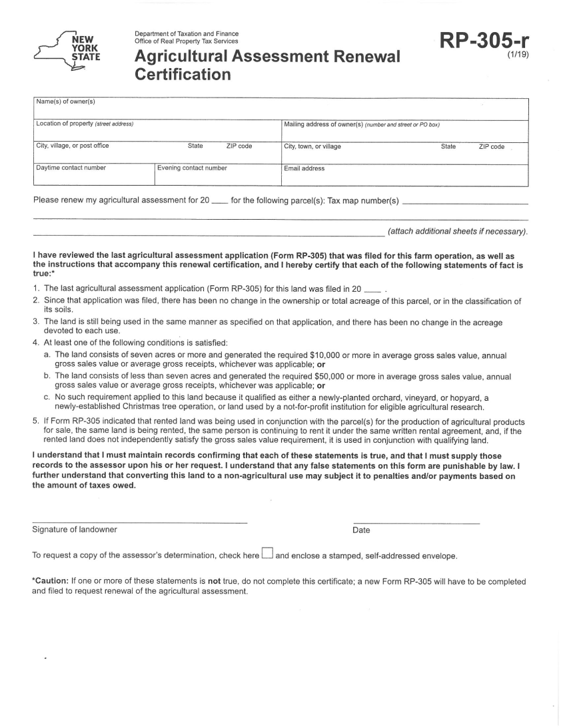
Agricultural Assessment Renewal

Slide 41
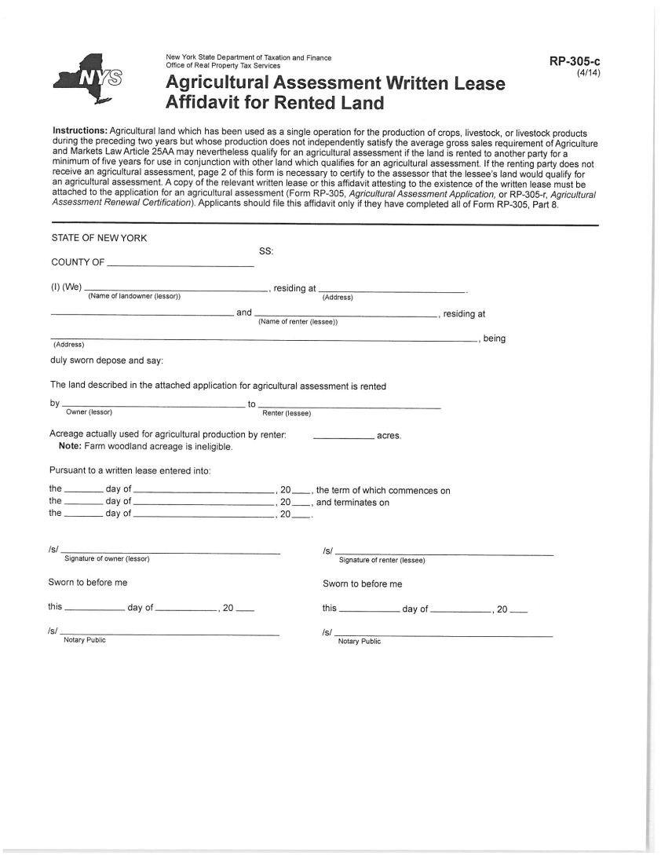
Agricultural Assessment Lease Agreement

